Slide 1
DIGITAL PORTFILO
STUDENT NAME : AMOKA S
REGISTER NO AND NMID : 24131210500122004/
asanm121anm12124213004
DEPARTMENT : BCA
COLLEGE : IMMACULATE COLLEGE FOR WOMEN
UNIVERSITY : ANNAMALAI UNIVERSITY

Slide 2
PROJECT TITLE
STUDENT PORTFOLIO

Slide 3
AGENTA
Problem and statement
Project overview
End user
Tools and technologies
Portfolio design and layout
Features and functionality
Results and screenshot
Conclusion
GitHub link

Slide 4
PROBLEM STATEMENT
This project aims to solve that problem by creating a simple, interactive portfolio website using HTML, CSS, and JavaScript.
The portfolio will allow developers to introduce themselves, list their skills, display projects, and provide contact information, while also incorporating basic JavaScript functionality to make the site more dynamic and engaging.

Slide 5
PROJECT OVERVIEW
This project is a personal portfolio website developed using HTML, CSS, and JavaScript. The main purpose of the project is to create a simple yet effective platform where a web developer can introduce themselves, showcase their skills, highlight completed projects, and share contact details.
The portfolio begins with a short introduction and a profile image, followed by an “About Me” section, a list of projects, and a contact section with email and LinkedIn links.

Slide 6
END USER
1. Potential Employers/Recruiters – to review the developer’s skills, projects, and contact details during job applications. 2. Clients – to evaluate the developer’s expertise before offering freelance or project-based work. 3. Peers and Collaborators – other developers or students who may want to connect, share knowledge, or collaborate on projects. 4. Academic Institutions – teachers or evaluators who may assess the developer’s practical coding knowledge.

Slide 7
TOOLS AND TECHNOLOGIES
HTML (HyperText Markup Language) – for structuring the content of the portfolio such as headings, paragraphs, images, and links. CSS (Cascading Style Sheets) – for styling the portfolio, including layout, colors, fonts, and visual design. JavaScript – for adding interactivity, such as displaying information dynamically and simulating project activity.

Slide 8
PORTFOLIO DESIGN AND LAYOUT
1. Header Section – Contains the portfolio title and a welcome message to introduce the developer. 2. Profile Image – Displays a personal photo to add identity and personalization. 3. About Me Section – Provides a short description of the developer, highlighting their role and interests. 4. Projects Section – Lists sample projects with short descriptions to showcase technical skills and experience. 5. Contact Section – Shares the developer’s email and LinkedIn profile for communication.

Slide 9
FEATURES AND FUNCTIONALITY
1. Introduction Section – Welcomes visitors with the portfolio title, a greeting message, and the developer’s profile image. 2. About Me Section – Briefly describes the developer’s role, background, and interests in web development. 3. Projects Section – Displays a list of sample projects with short descriptions to showcase practical skills. 4. Contact Section – Provides direct contact information, including email and LinkedIn profile, for easy communication.

Slide 10
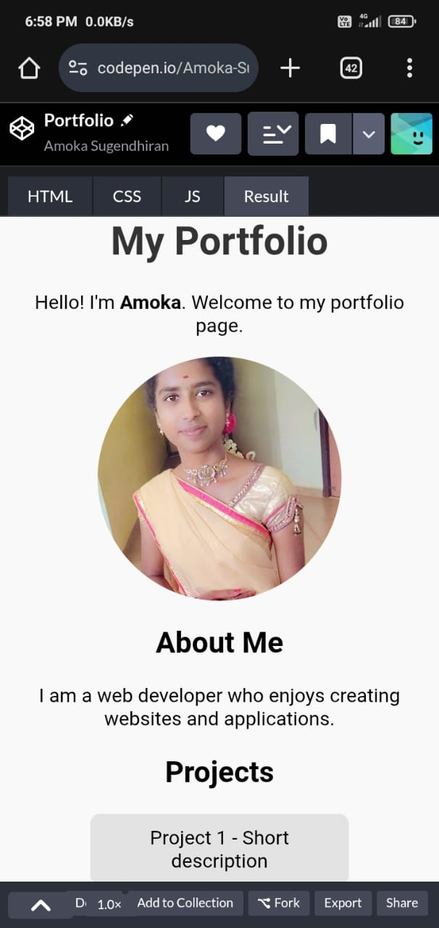
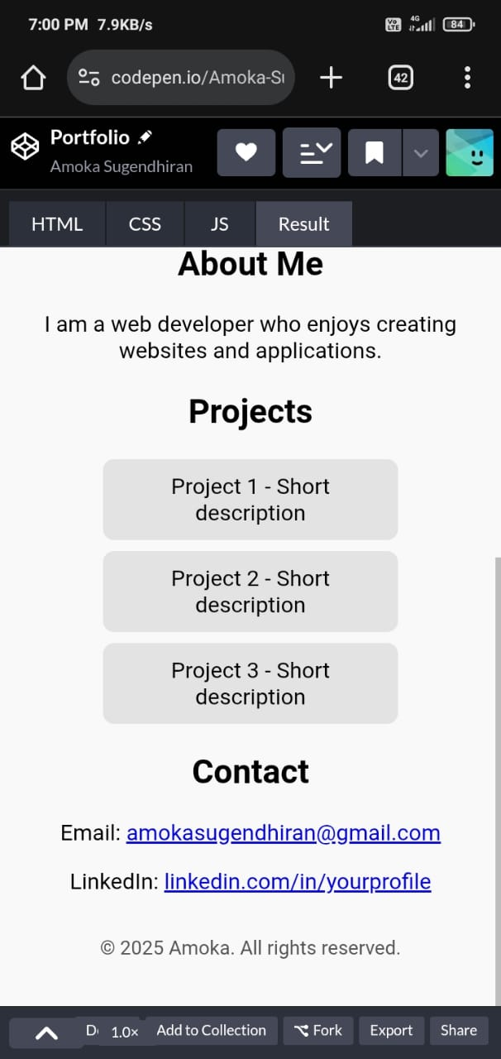
RESULTS AND SCREENSHOT

Slide 11
CONCLUSION
This project successfully demonstrates how a simple portfolio website can be created using HTML, CSS, and JavaScript. The portfolio provides an effective platform for introducing the developer, highlighting skills, showcasing projects, and sharing contact details.

Slide 12
GITHUB LINK
https://amokasugendhiran-ship-it.github.io/amoka-TNSDC-FWD-DP/

